Slide 1
PhilaSUG Spring Meeting June 05, 2019
Sujaykumar Bothisathuvan

Slide 2
What is SDTM Metadata?
SDTM Metadata is a set of inputs from various sources which is used to build
SDTM datasets in an effective way.
Let’s look into a sample SAS code: data dm; set sourcedata.demographics; length usubjid $ 24 race $ 30; label usubjid = “Unique Subject ID” race = “Race”; usubjid = put(subject,10.); if nrace = 1 then race = ‘WHITE’; else if nrace = 2 then race = ‘BLACK OR AFRICAN AMERICAN’; else if nrace = 3 then race = ‘OTHER’; run;

Slide 3
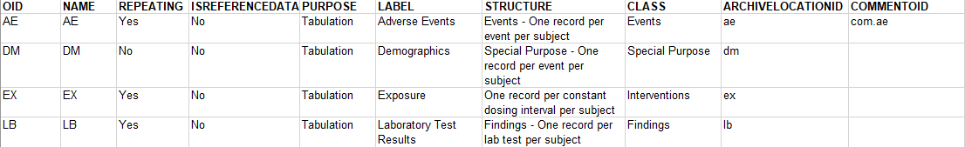
Table of Contents Metadata
The Table of Contents metadata represents the data required to produce the Table of
Contents section of the define.xml file.
The Table of Contents in define.xml file is a list of the domain datasets, it lists out the structure of each dataset, class, purpose and it also has the Key variables for each dataset. It also has a link that directs you to the respective dataset within the define file.
An example of Table of Contents metadata is shown below;

Slide 4
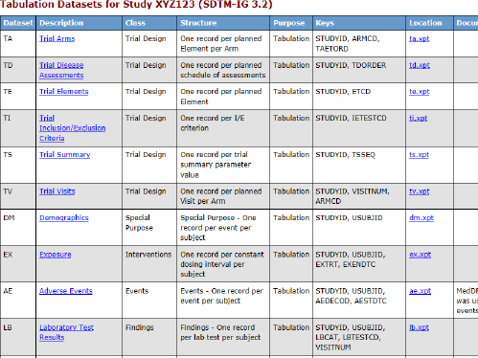

Slide 5
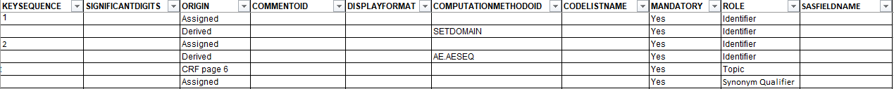
Variable-level Metadata
Varaible-level metadata is used to define the domain or dataset variable content.
This metadata contains definitions such as your SAS label, SAS variable type, SAS variable length, any codelist name, and other associated metadata.
Each row in this metadata represents a variable in an SDTM domain dataset.
An example of Variable-level metadata is shown below;

Slide 6
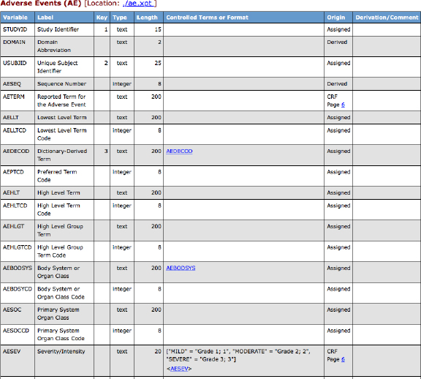

Slide 7
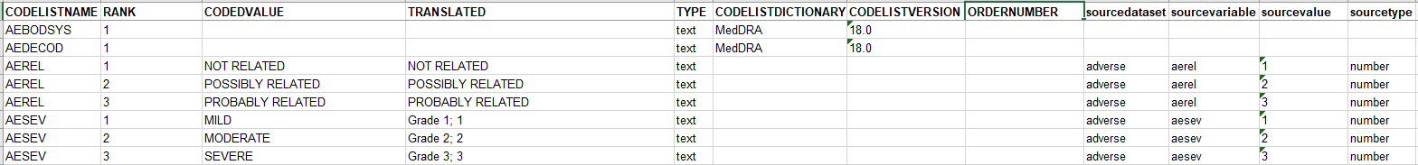
Codelist Metadata
Codelists are the ‘controlled terminology’ applied to the SDTM variables.
The SEX variable in the DM domain has the CDISC-defined controlled terminology set called “SEX,” which includes M=Male, F=Female, and other codes.
CDISC standard SDTM codelists can be found in the CDISC website at http://www.cdisc.org/standards/foundational/terminology.
An example of Codelist metadata is shown below;

Slide 8
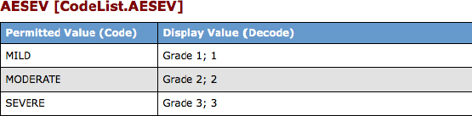

Slide 9
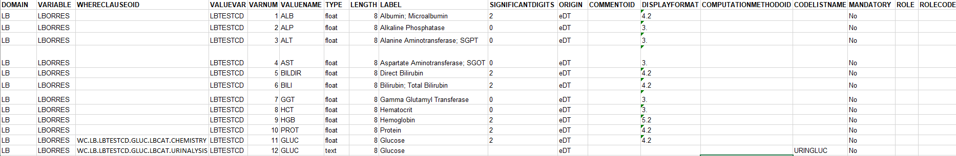
Value-level Metadata
Value-level metadata contain somewhat more specification on a given record.
An example of Value-level metadata is shown below;

Slide 10
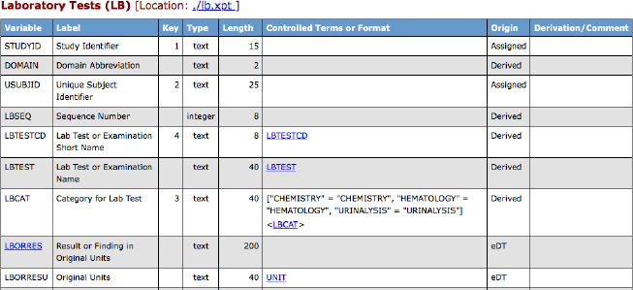

Slide 11
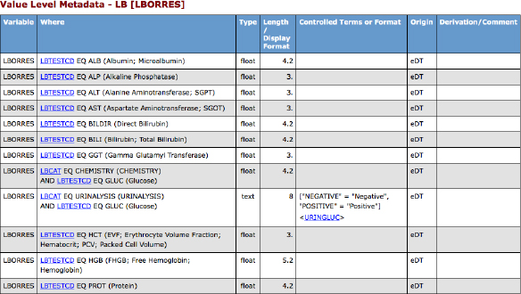
If you click on that hyperlink (./lb.xpt), it takes you to the value-level metadata table where you can see the value-level metadata for LBORRES:
As seen, most “values” are defined simply by LBTESTCD. But in the case of glucose, we also need to consider the value of LBCAT to distinguish between the blood chemistry and urinalysis results. The urinalysis result is the only character one, and it has a code list associated with it.

Slide 12
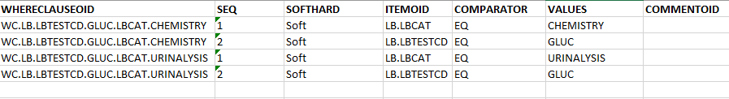
Where Clause Metadata
Although ‘where clauses’ exist in define.xml for every value level metadata item, they only need to be specified in the metadata spreadsheet for records that cannot be uniquely identified by only one variable value.
For example, for albumin value-level metadata, the macro creates a WHERECLAUSEOID equal to WC.LB.ORRES.ALB, and this where clause is designed to check for LBTESTCD EQ ALB.
The following screen shot demonstrates how the glucose-related where clauses are captured in spreadsheet.

Slide 13
Computational Method Metadata
As the name suggests, the computations that takes place in SDTM data is stored here.
Total scores for a questionnaire, derived laboratory values, and AGE variable in DM can be considered derived content.
An example of Computational Method metadata is shown below;

Slide 14

Comments Metadata
The Comments metadata spreadsheet provides a common place to specify unique comments.
An example of Comments metadata is shown below;

Slide 15
External Links
The SDTM define file has links to two documents: the annotated CRFs and a reviewer’s guide. Adding to those, any additional supplemental documents should now be specified in the External Links spreadsheet.
An example of External Links is shown below;

Slide 16
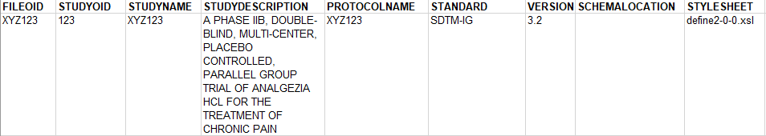
Define File Header Metadata
The header information for define.xml is described below;

Slide 17
Summary
The best approach to implement SDTM in Base SAS is through the heavy use of metadata to drive the conversion process.
Build a metadata repository to hold your SDTM metadata, both to make conversions easier and to make building define.xml file possible.

Slide 18
Reference
Implementing CDISC Using SAS – Jack Shostak & Chris Holland.

Slide 19
Questions?

